Slide 1






Data Security and Cryptology -
Final Project
Secure payment, Schnorr Signature for server identification. SM4 encoder – decoder ECDH key generation.
Dor Shabat - 316575620
Yuval Rozner - 207756552
Our Implemantion in Colab Notebook

Slide 2
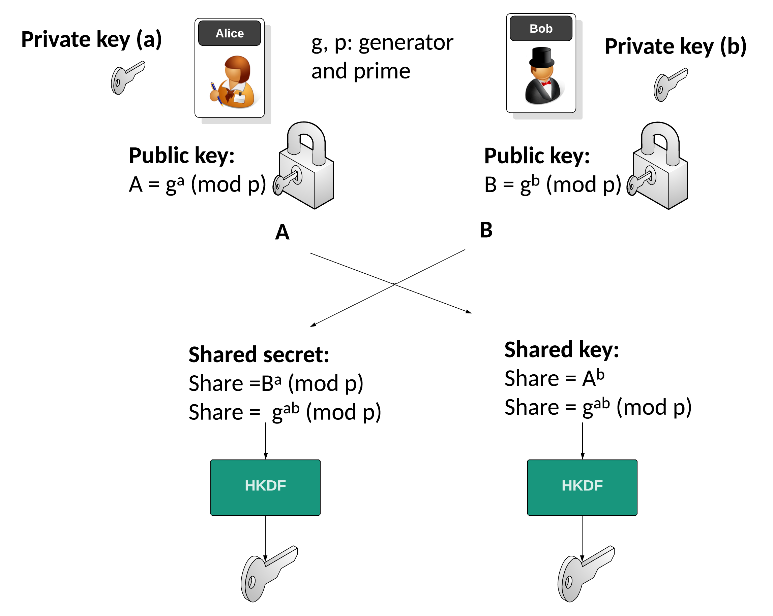
ECDH
Elliptic Curve Diffie-Hellman

Slide 3
What is ECDH ?
Secure Key Exchange:
In cryptography, secure key exchange is crucial for protecting communication channels.
Ensures that only the intended parties can access the shared secret key.
Evolution of Diffie-Hellman:
The classical Diffie-Hellman key exchange method was introduced in 1976.
ECDH (Elliptic Curve Diffie-Hellman) is an advanced version, leveraging elliptic curves for enhanced security and efficiency.

Slide 4
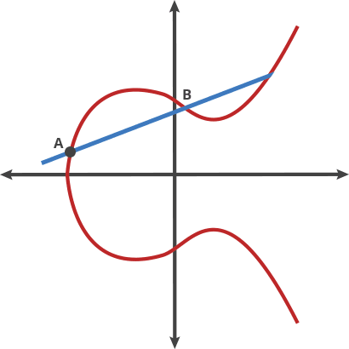
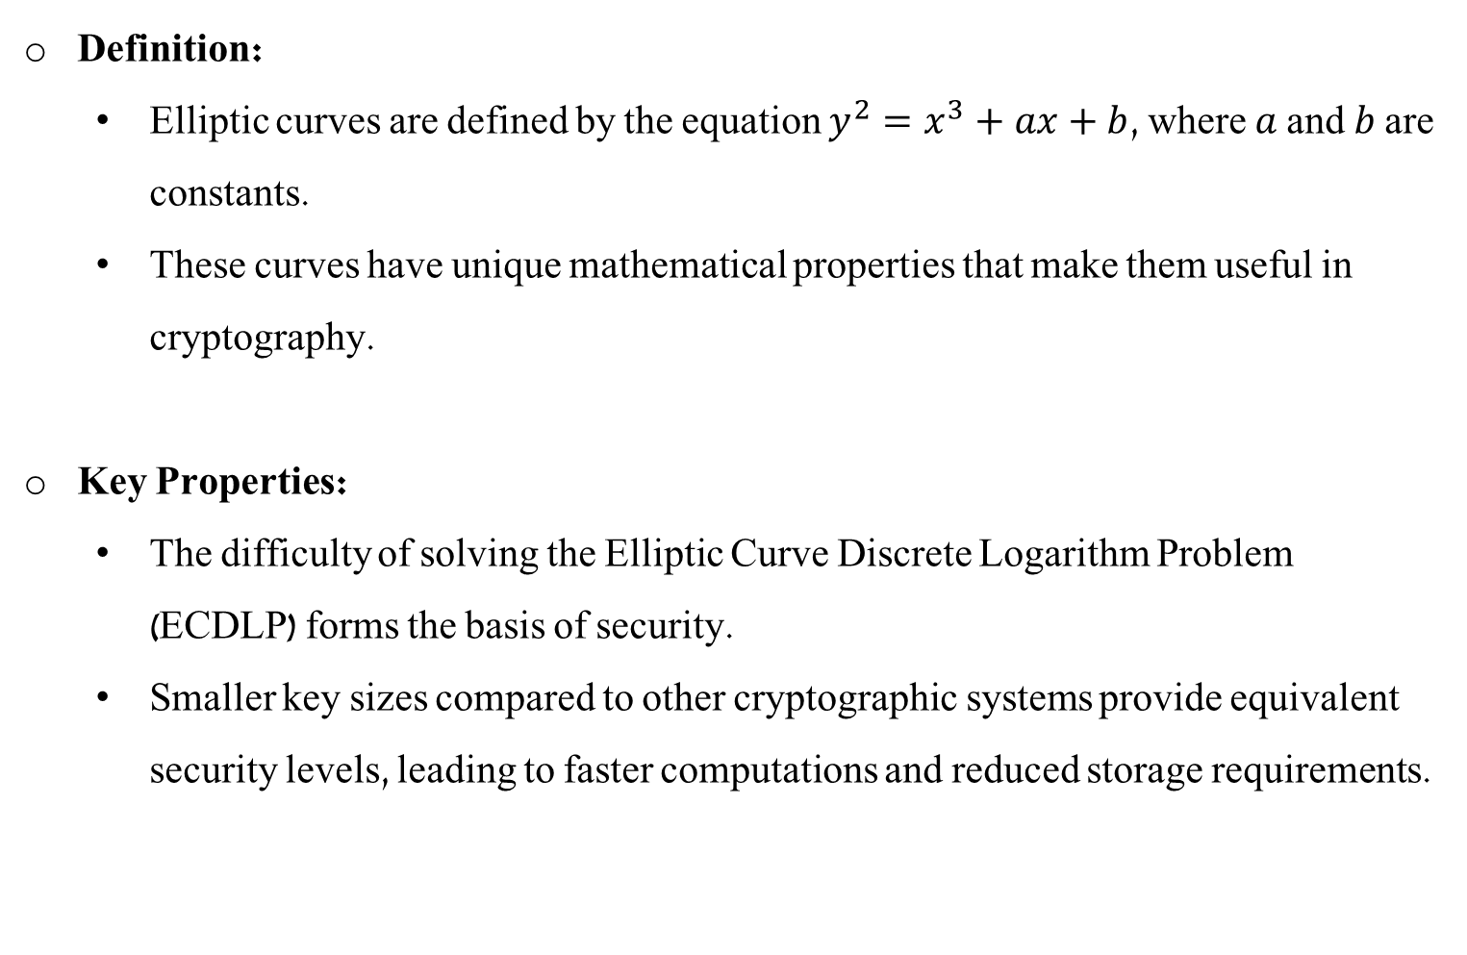
Basics of Elliptic Curves
Definition:
Elliptic curves are defined by the equation $y^{2}=x^{3}+ax+b$, where $a$ and $b$ are constants.
These curves have unique mathematical properties that make them useful in cryptography.
Key Properties:
The difficulty of solving the Elliptic Curve Discrete Logarithm Problem (ECDLP) forms the basis of security.
Smaller key sizes compared to other cryptographic systems provide equivalent security levels, leading to faster computations and reduced storage requirements.

Slide 5
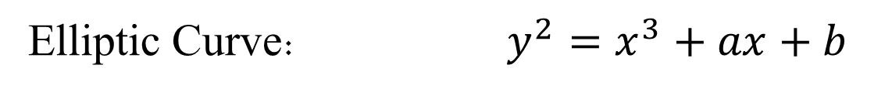
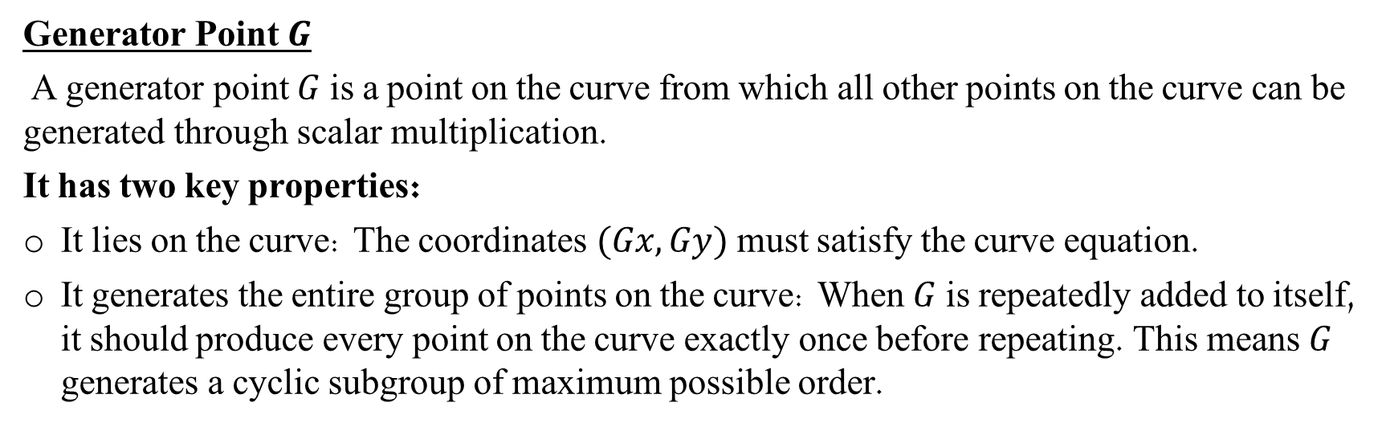
Mathematics definitions
Elliptic Curve: $y^{2}=x^{3}+ax+b$
$a , b$ requirements: $4a^{3}+27b^{2} !≡ 0\left(mod\right)P$
$G$ : generator: $(G_{X} , G_{y})$
Generator Point $G$
A generator point $G$ is a point on the curve from which all other points on the curve can be generated through scalar multiplication.
It has two key properties:
It lies on the curve: The coordinates $(Gx,Gy)$ must satisfy the curve equation.
It generates the entire group of points on the curve: When $G$ is repeatedly added to itself, it should produce every point on the curve exactly once before repeating. This means $G$ generates a cyclic subgroup of maximum possible order.

Slide 6
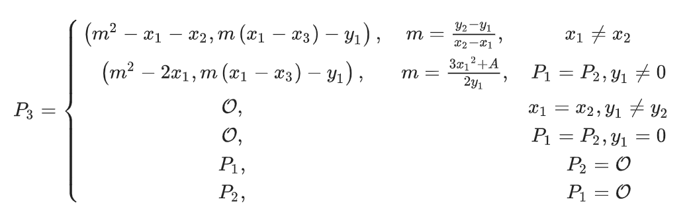
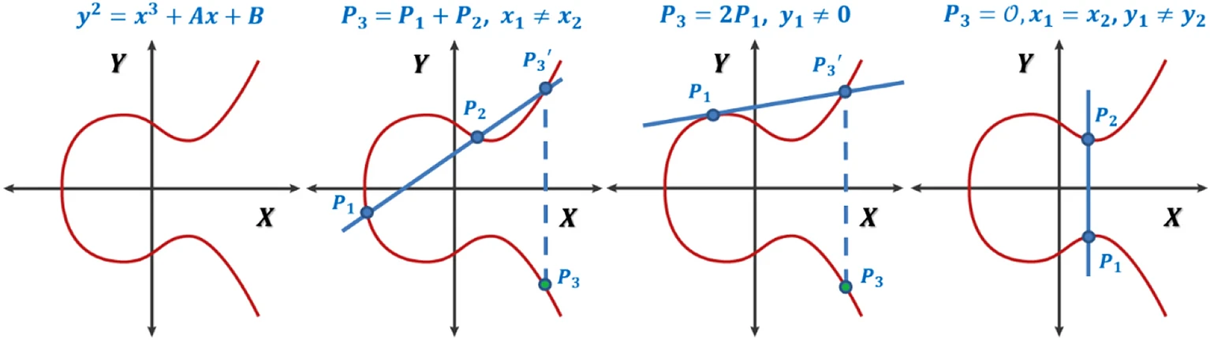
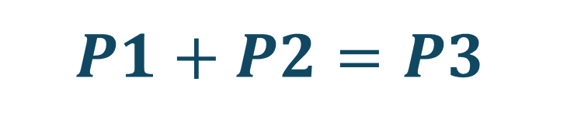
$$P1+P2=P3$$

Slide 7
Key Exchange Principles
Overview of Key Exchange:
Key exchange is the process by which cryptographic keys are securely shared between parties.
Ensures that both parties can communicate securely without prior shared secret keys.
Public and Private Keys:
Each party generates a pair of keys: a private key (kept secret) and a public key (shared openly).
The security of the system relies on the private key remaining confidential.

Slide 8
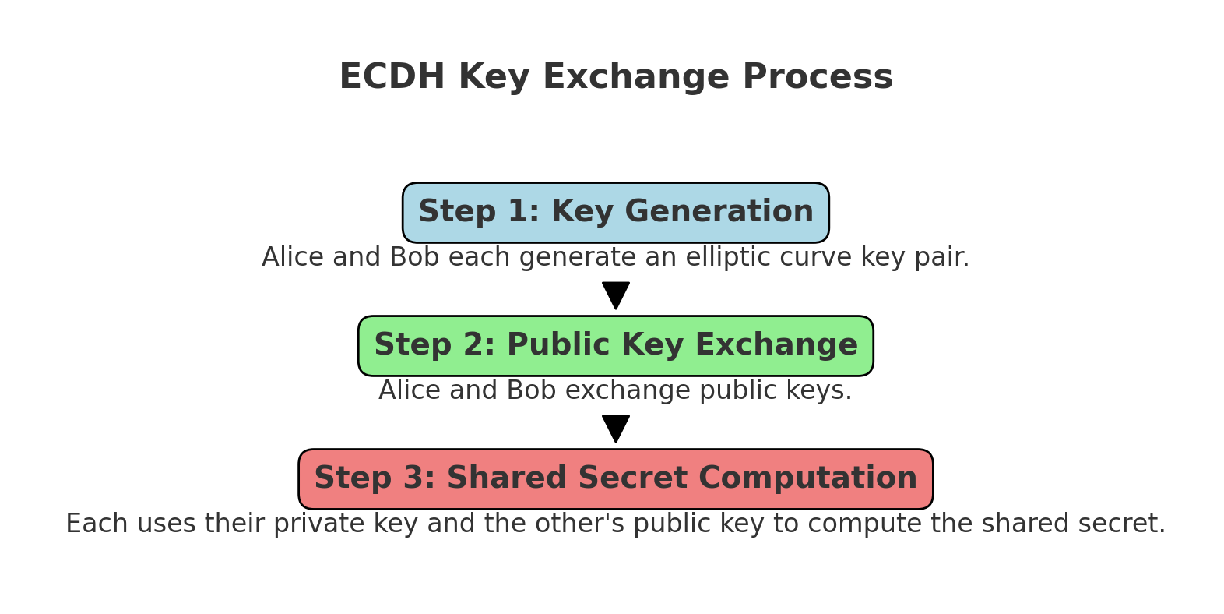
Key Exchange Process

Slide 9
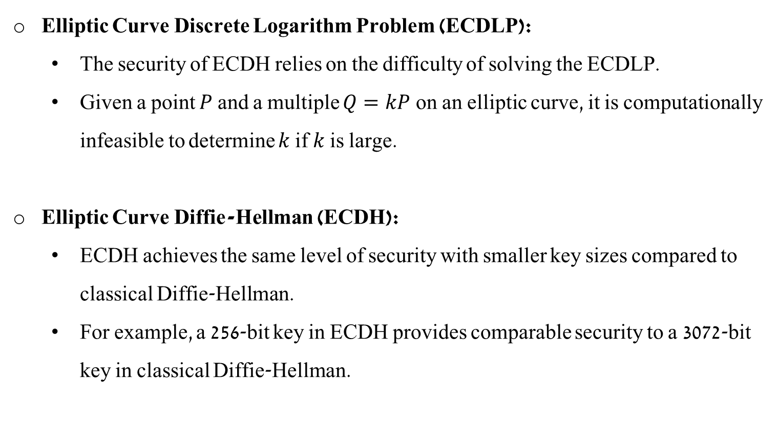
Security Aspects of ECDH
Elliptic Curve Discrete Logarithm Problem (ECDLP):
The security of ECDH relies on the difficulty of solving the ECDLP.
Given a point $P$ and a multiple $Q=kP$on an elliptic curve, it is computationally infeasible to determine $k$ if $k$ is large.
Elliptic Curve Diffie-Hellman (ECDH):
ECDH achieves the same level of security with smaller key sizes compared to classical Diffie-Hellman.
For example, a 256-bit key in ECDH provides comparable security to a 3072-bit key in classical Diffie-Hellman.

Slide 10
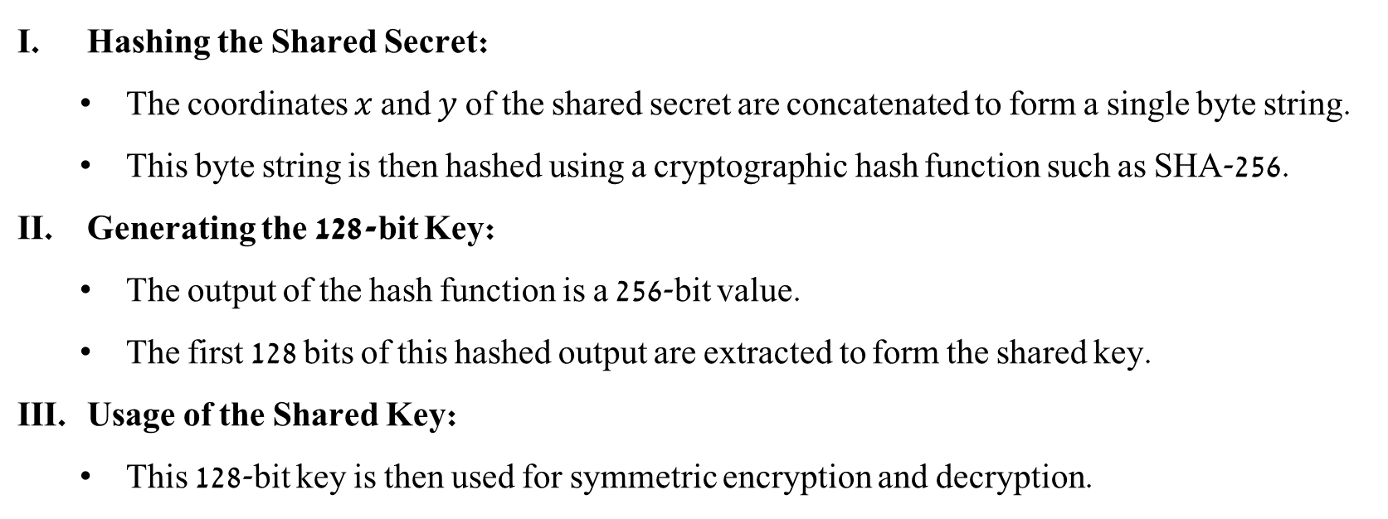
Deriving a Shared Key from the Shared Secret
Once both parties compute the shared secret point $(x,y)$ on the elliptic curve,
they need to derive a shared key for encryption and decryption.
Hashing the Shared Secret:
The coordinates $x$ and $y$ of the shared secret are concatenated to form a single byte string.
This byte string is then hashed using a cryptographic hash function such as SHA-256.
Generating the 128-bit Key:
The output of the hash function is a 256-bit value.
The first 128 bits of this hashed output are extracted to form the shared key.
Usage of the Shared Key:
This 128-bit key is then used for symmetric encryption and decryption.

Slide 11

SM4

Slide 12


SM4 A Chinese National Standard for Block Cipher
SM4 is a symmetric key block cipher algorithm developed by the Chinese State Cryptography Administration.
Developed by the Chinese government.
Designed to provide secure communication in wireless networks.

Slide 13
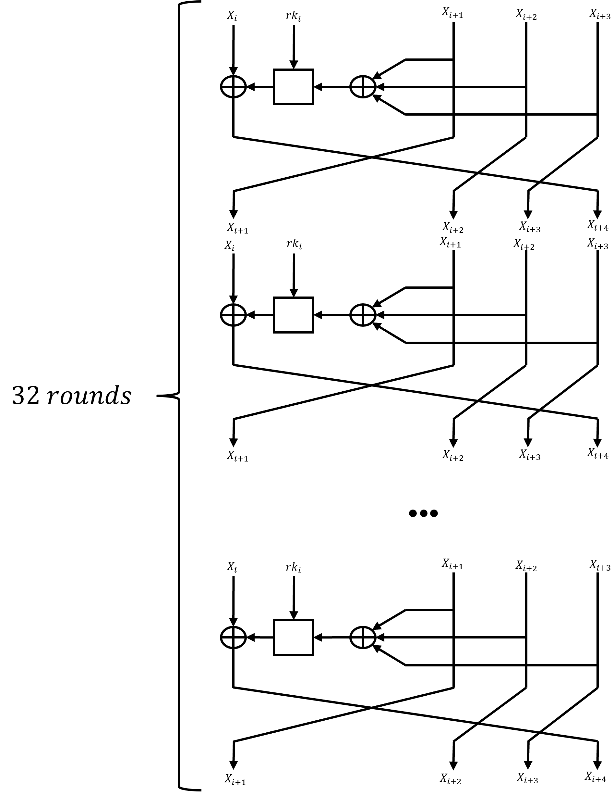
Configuration
Symmetric block cipher.
Key size: 128 bit.
Block size: 128 bit.
Rounds: 32.
Structure: unbalanced Fiestel network.
Notes:
Symmetric block cipher – ההצפנה מתבצעת בבלוקים.
Key size 128 bit – זה לא המפתח הכי ארוך שנחשפנו אליו בשיעורים (לעומת AES ), זה בעצם איזון בין אבטחה לבין ביצועים.
Block size – 128 bit – הצפנה של בלוק יחסית בגודל סביר, אנחנו מדברים על גודל שווה ל גודל של AES
Rounds 32 – לשם ניסיון לאבטחה גבוהה ולהגדיל את הבלבול על הטקסט המוצפן אנו מבצעים 32 rounds שמשלבים בתוכם sbox ו שיפט ו xor .
unbalanced Fiestel network –
מתבסס על ארכיטקטורת fiestel , אך שהם לקחו את זה להיות unbalanced כלומר לא חלופה בין החצי הראשון לשני אלא כמו הזזה.
בגלל שאנחנו תחת fiestel ארכיטקטורה , הdecription יעבוד אותו דבר כמו ה encription אבל עם מפתחות בסדר הפוך.
ניתן לראות שה הושפעו גם מה AES וגם מה DES , באחד מהארכיטקטורה, באחר הם לקחו גדלים ופרמטרים.

Slide 14
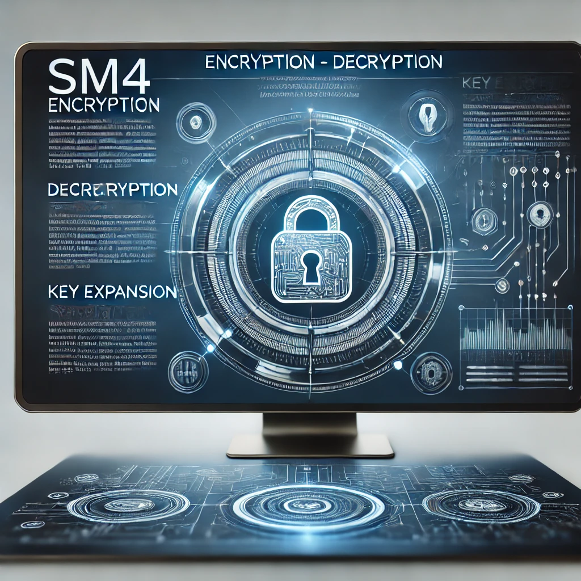
SM4
Encyption – Decryption
Key Expension

Slide 15
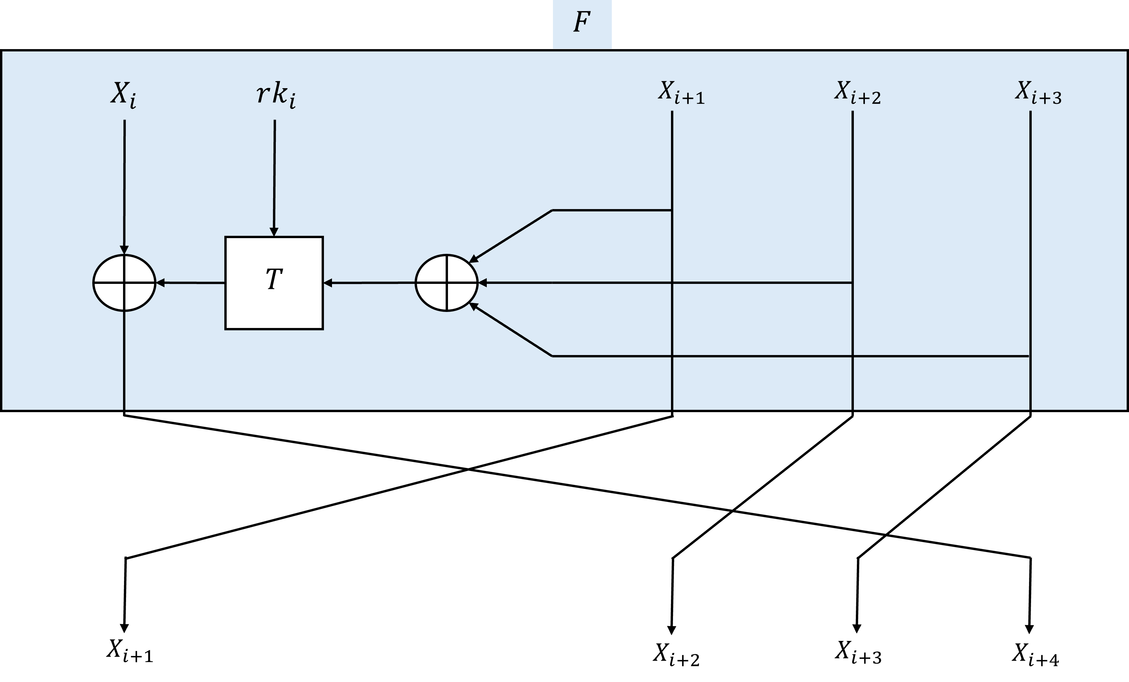
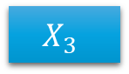
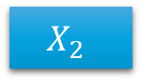
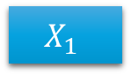
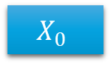
Round
Plaintext
128
$$X_{0}$$
$$X_{1}$$
$$X_{2}$$
$$X_{3}$$
32
32
32
32
Notes:
ה plaintext מופרד ל 4 חלקים x1, x2, x3,x4 כאשר כל גודל הוא 32 bit .

Slide 16
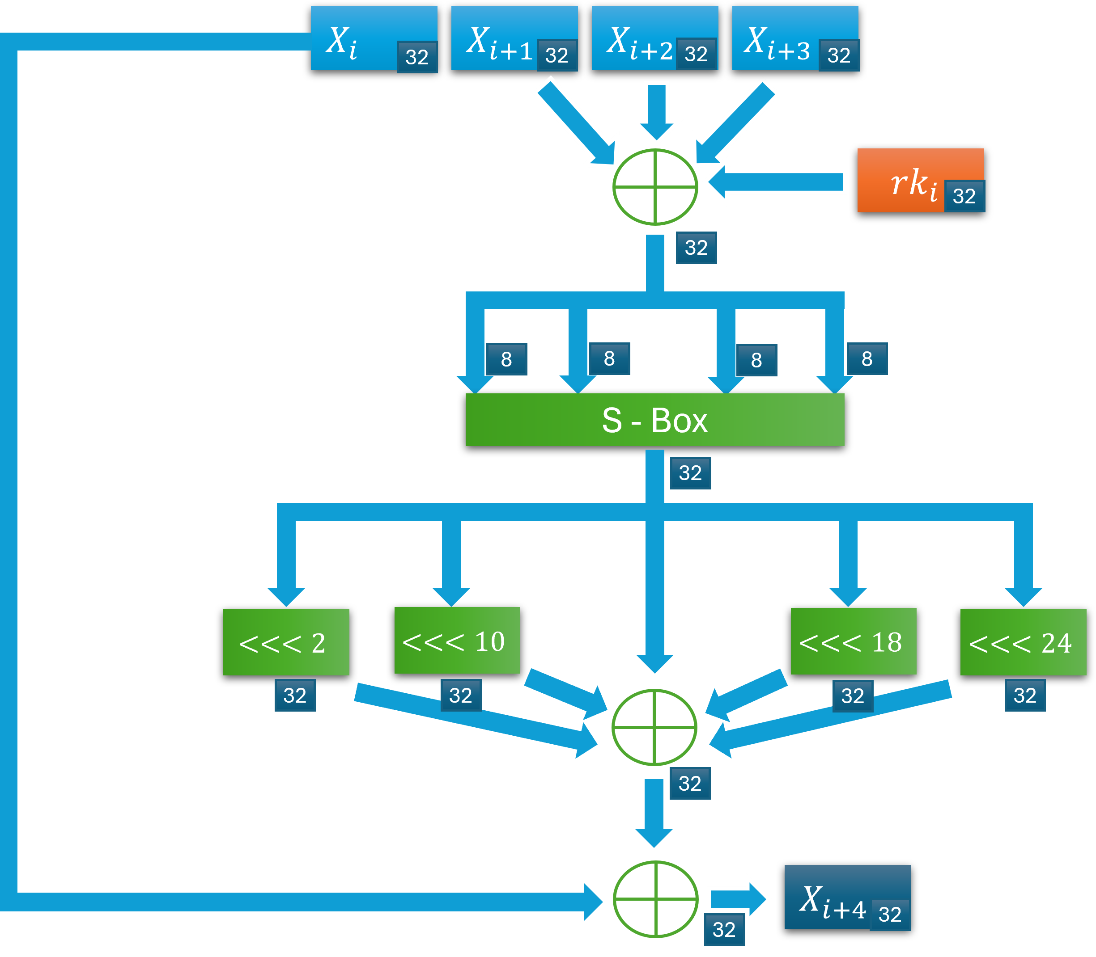
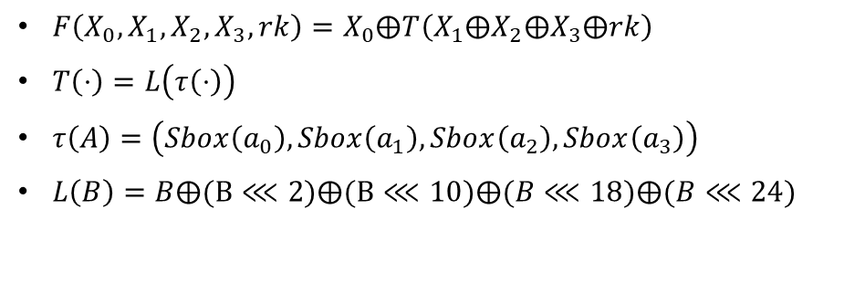
Function F
$F\left(X_{0},X_{1},X_{2},X_{3},rk\right)=X_{0}⨁T\left(X_{1}⨁X_{2}⨁X_{3}⨁rk\right)$
$T\left(⋅\right)=L\left(τ\left(⋅\right)\right)$
$τ\left(A\right)=\left(Sbox\left(a_{0}\right),Sbox\left(a_{1}\right),Sbox\left(a_{2}\right),Sbox\left(a_{3}\right)\right)$
$L\left(B\right)=B⨁(B⋘2)⨁(B⋘10)⨁(B⋘18)⨁(B⋘24)$
Notes:
אלגוריתמי encryption decryption מתבססים על שני מונחים עיקריים.
Confusion
Diffusion
Confusion – בלבול – בעצם מתייחס לחלופה של אות באות. ניתן לראות את זה ב sbox
Diffusion – פיזור – החלפת מקומות של הטקסט במקומות אחרים. ניתן לראות את זה ב shift L

Slide 17
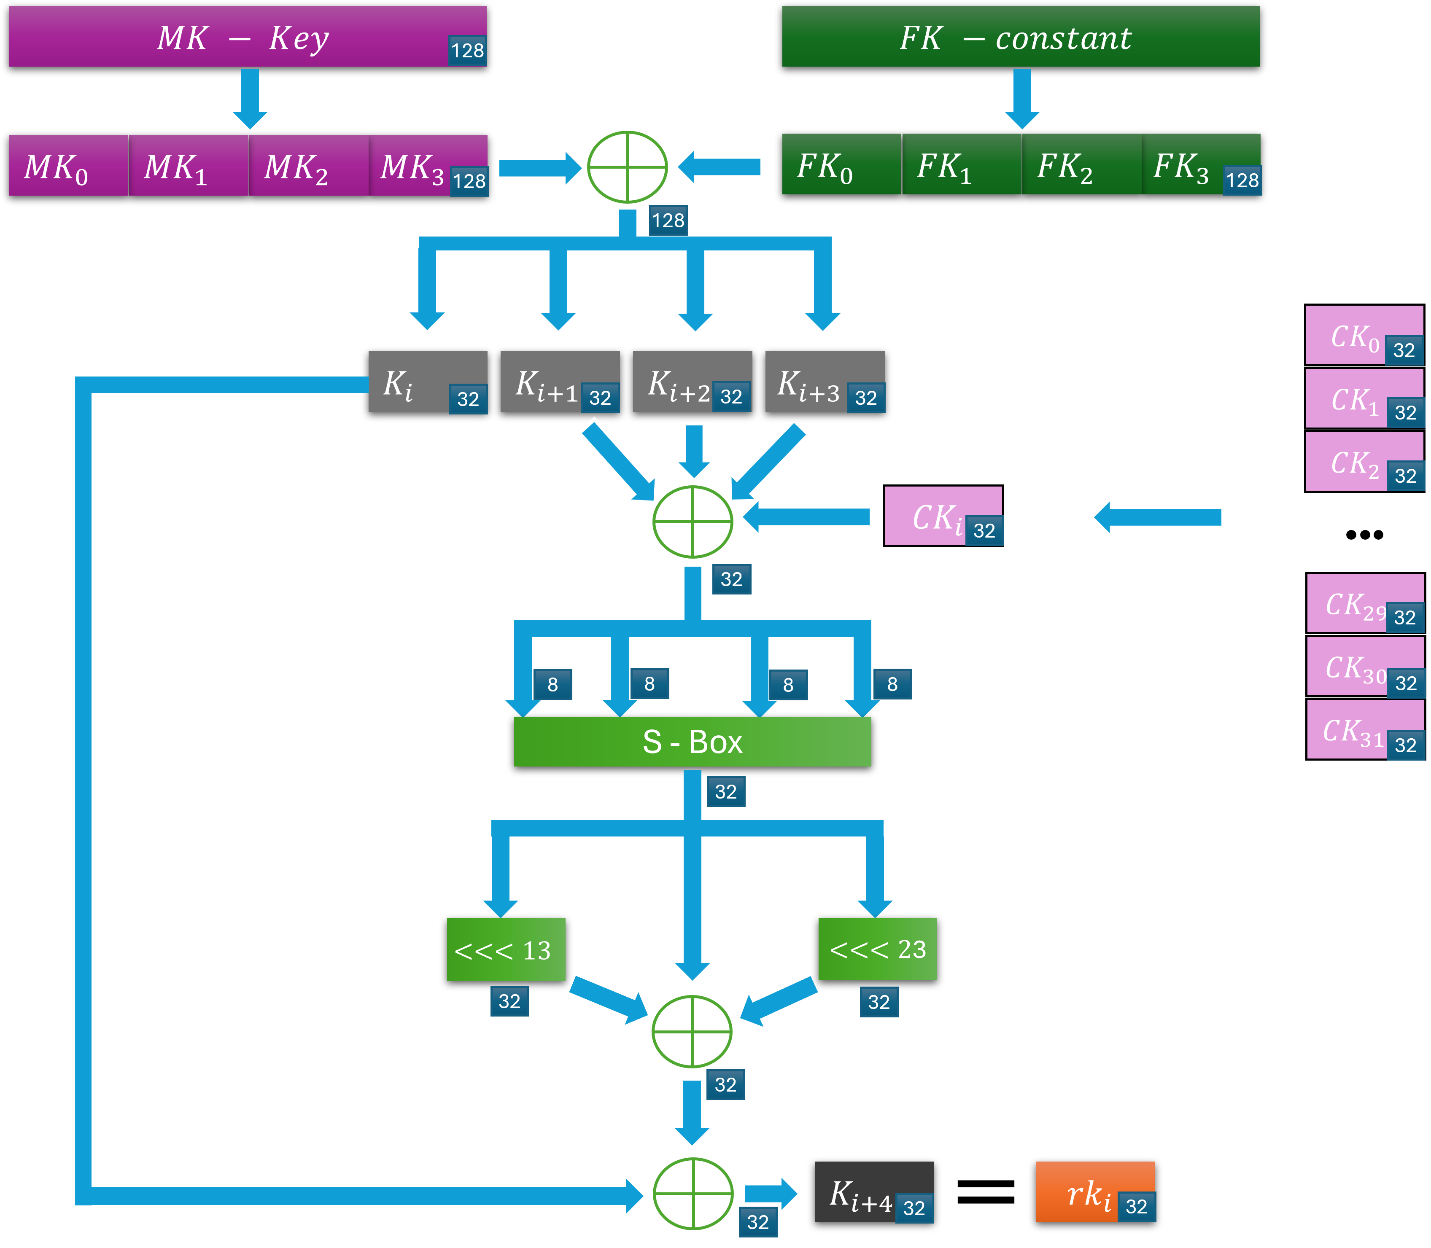
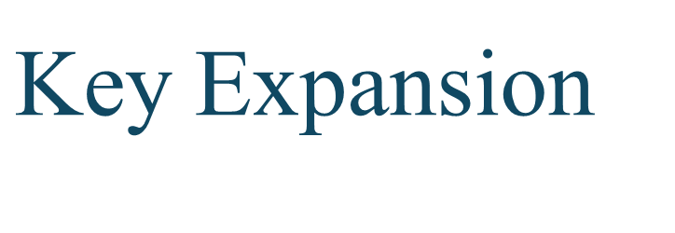
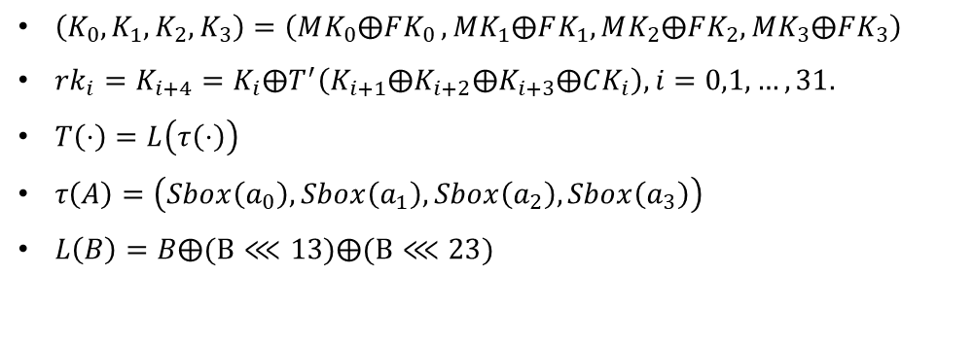
$$\text{Key} \text{Expansion}$$
$\left(K_{0},K_{1},K_{2},K_{3}\right)=\left(MK_{0}⨁FK_{0 },MK_{1}⨁FK_{1},MK_{2}⨁FK_{2},MK_{3}⨁FK_{3}\right)$
$rk_{i}=K_{i+4}=K_{i}⨁T^{′}\left(K_{i+1}⨁K_{i+2}⨁K_{i+3}⨁CK_{i}\right), i=0,1,…,31.$
$T\left(⋅\right)=L\left(τ\left(⋅\right)\right)$
$τ\left(A\right)=\left(Sbox\left(a_{0}\right),Sbox\left(a_{1}\right),Sbox\left(a_{2}\right),Sbox\left(a_{3}\right)\right)$
$L\left(B\right)=B⨁(B⋘13)⨁(B⋘23)$
Notes:
לפי שנתחיל לבצע encription ניצור את כל המפתחות שלנו . נעשה זאת על ידי השקף הבא
MK זה המפתח שלנו – אורכו 128 ביט.
את , FK קיבלנו . 128 ביט.
את CK גם קיבלנו , אבל קיבלנו 32 ck שונים באורך 32 עבור כל סיבוב.

Slide 18
Security Analysis of SM4
Strengths of SM4
Block Cipher
Key Size and Block Size:
128-bit Key Size: Strong security against brute-force attacks.
128-bit Block Size: Effective balance between security and efficiency.
Number of Rounds:
32 Rounds: Enhances diffusion and confusion, increasing cryptanalytic complexity.
Use of S-Boxes:
Confusion via S-Boxes: Obscures the relationship between key and ciphertext.
Shift rows:
Diffusion via Permutation: Spreads influence of plaintext bits across ciphertext.

Slide 19
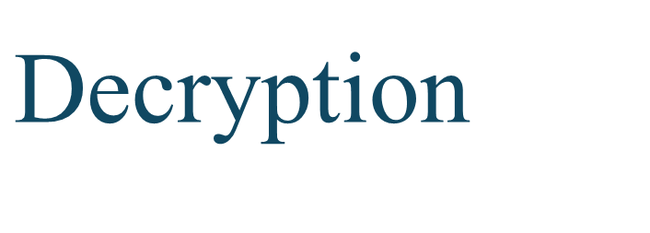
$$\text{Decryption}$$
Inverse Key Expansion:
Like encryption, decryption also relies on key expansion but in reverse order.
Unbalanced Feistel Network:
Utilizes an unbalanced Feistel structure where decryption mirrors encryption with reversed subkeys.
Plaintext Recovery:
Ciphertext is divided into 128-bit blocks.
Each block undergoes 32 rounds of decryption using the subkeys.
Decryption rounds incorporate inverse operations of S-box, linear transformation, and key mixing.

Slide 20
SM4 VS AES VS DES
Algorithm | Block Size | Key Size | Number of Rounds | Security
SM4 | 128 bits | 128 bits | 32 | Strong
AES | 128 bits | 128, 192, 256 bits | 10, 12, 14 | Strong
DES | 64 bits | 56 bits | 16 | Insecure

Slide 21

Preventing $Man_In_The_Middle$attack
SM4 encryption can be vulnerable to Man-In-The-Middle (MITM) attacks.
To prevent this, we will use Digital Signature (Schnorr Signature) to ensure secure authentication and integrity.
This approach guarantees that the messages are authentic and have not been tampered with, leading to a more secure communication channel.

Slide 22
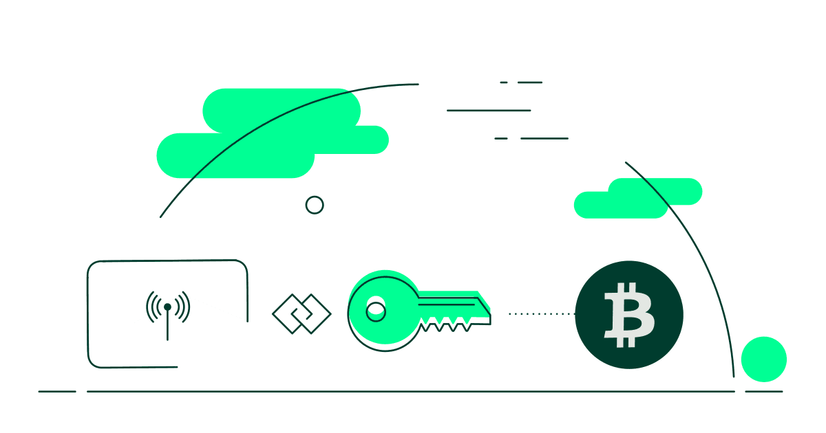
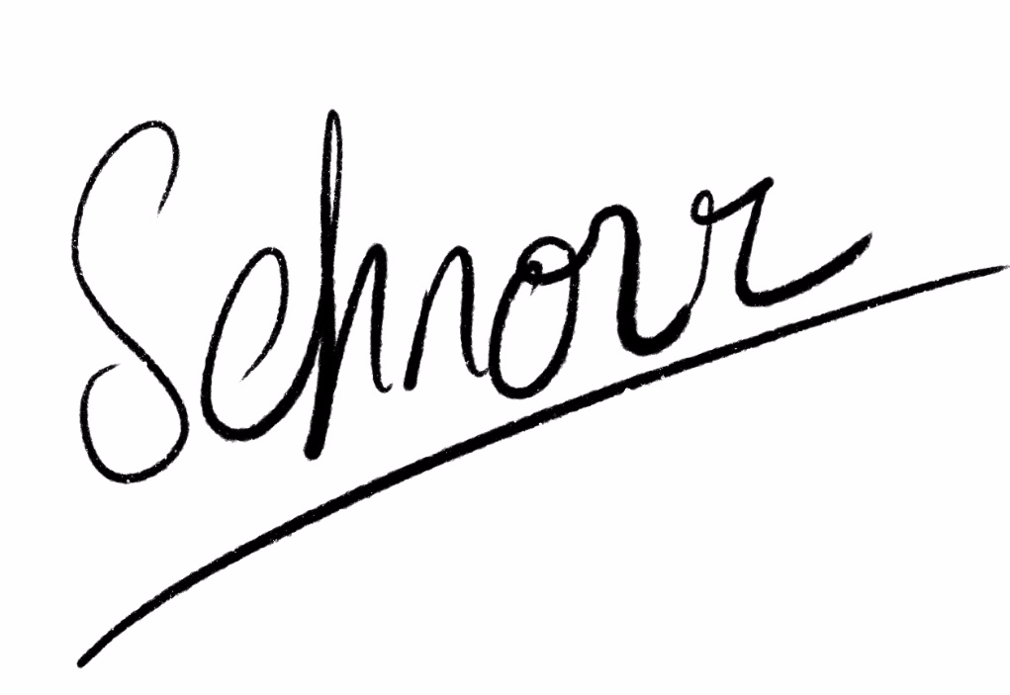
Schnorr Signature

Slide 23
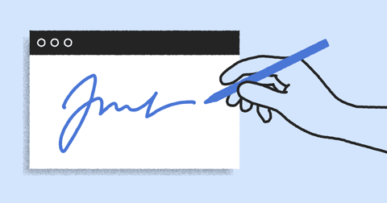
Why Digital Signature ?
Digital signatures are crucial in cryptography, ensuring message authenticity and integrity.
They verify the sender's identity and protect against message tampering.
Authenticity: Confirms the sender's identity.
Integrity: Ensures the message hasn't been altered.
Prevents Man-in-the-Middle Attacks: Stops attackers from intercepting and modifying messages.
Non-repudiation: The sender cannot deny having sent the message.
Digital signatures are essential in email, financial transactions, and legal documents.
Notes:
חתימות דיגיטליות חשובות באבטחת מידע:
- הן מסייעות לנו לאמת את זהות השולח.
- לוודא את שלמות ההודעה (שלא שינו לנו אותה בדרך).
- למנוע התקפות איש בבדרך.
- להימנע מצב שבו השולח יכול להתנער משליחת ההודעה.

Slide 24
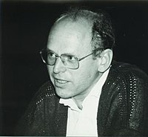
What is Schnorr Signature ?
Schnorr Signature is a digital signature algorithm known for its simplicity, efficiency, and security.
Invented by: Claus-Peter Schnorr.
Advantages:
More efficient than many other digital signature algorithms.
Provides strong security guarantees.
Applications: Used in various cryptographic protocols and blockchain technologies.
Notes:
הומצא על ידי קלאוס פטר סנור.
יעיל יותר מרוב החתימות הדיגיטליות שקיימות היום.

Slide 25
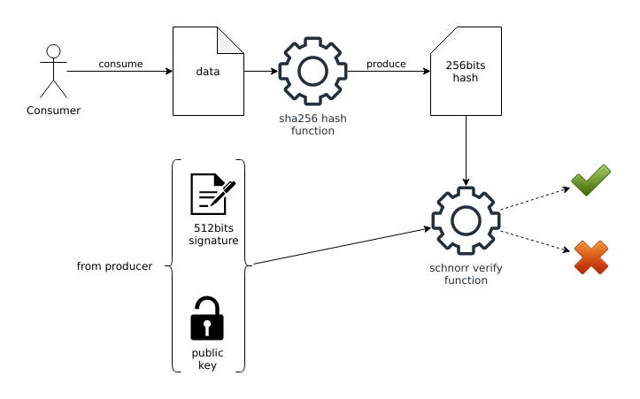
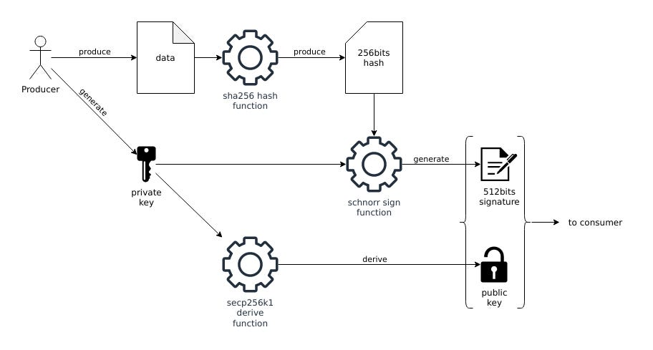
Schnorr Signature Diagrams
sender
receiver

Slide 26
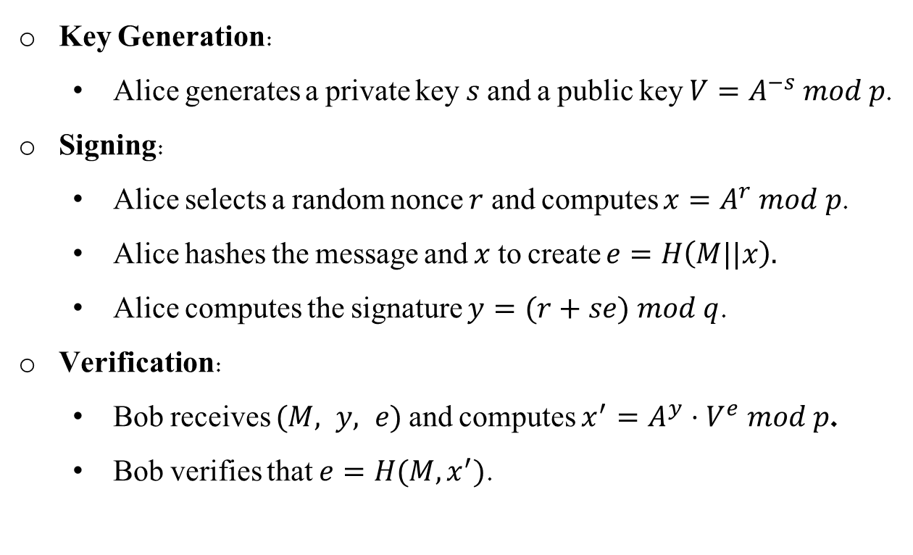
Schnorr Signature Algorithm
Algorithm Steps:
Key Generation:
Alice generates a private key $s$ and a public key $V=A^{−s} mod p$.
Signing:
Alice selects a random nonce $r$ and computes $x=A^{r} mod p$.
Alice hashes the message and $x$ to create $e=H\left(M||x\right).$
Alice computes the signature $y=(r+se) mod q$.
Verification:
Bob receives $(M, y, e)$ and computes $x^{′}=A^{y}⋅V^{e} mod p$.
Bob verifies that $e=H(M, x^{′})$.
Notes:
הומצא על ידי קלאוס פטר סנור.
יעיל יותר מרוב החתימות הדיגיטליות שקיימות היום.

Slide 27
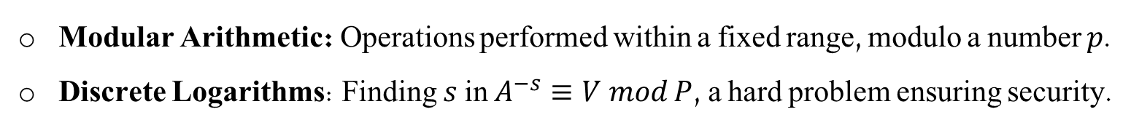
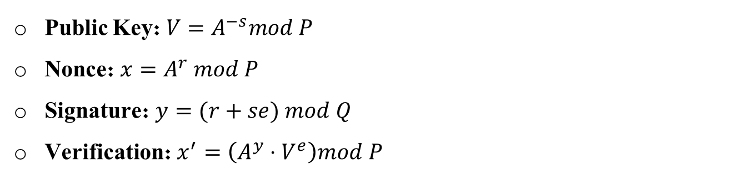
Mathematical Foundations
Mathematical Concepts:
Modular Arithmetic: Operations performed within a fixed range, modulo a number 𝑝.
Discrete Logarithms: Finding $s$ in $A^{−s}≡V mod P$, a hard problem ensuring security.
Key Equations:
Public Key: $V=A^{−s}mod P$
Nonce: $x=A^{r} mod P$
Signature: $y=(r+se) mod Q$
Verification: $x^{′}=\left(A^{y}⋅V^{e}\right)mod P$
Notes:
הומצא על ידי קלאוס פטר סנור.
יעיל יותר מרוב החתימות הדיגיטליות שקיימות היום.

Slide 28



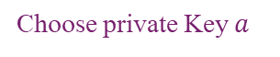

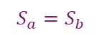
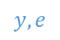
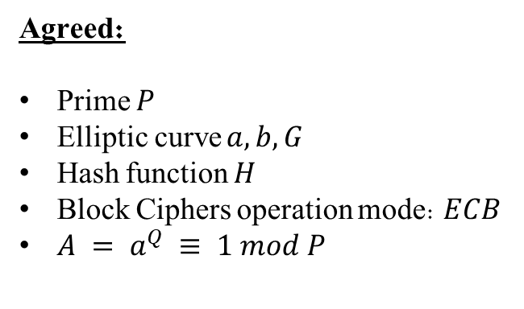



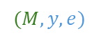

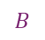
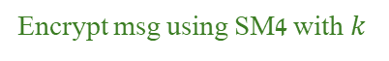
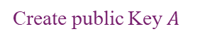
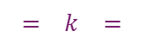


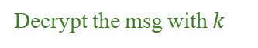
General flow
Alice
Bob
Choose private Key $a$
Choose private Key $b$
Create public Key $A$
$$A$$
$$B$$
Create public Key $B$
Calc shared secret $S_{a}$
$$S_{a}=S_{b}$$
Calc shared secret $S_{b}$
Derive shared key $k$
$$= k =$$
Derive shared key $k$
Agreed:
Prime $P$
Elliptic curve $a, b, G$
Hash function $H$
Block Ciphers operation mode: $ECB$
$A = a^{Q} ≡ 1 mod P$
Split msg into blocks
Encrypt msg using SM4 with $k$
Create a unique signature
$$y, e$$
Sign the msg
$$(M, y, e)$$
Send to Bob
Split cyphered msg into blocks
Decrypt the msg with $k$
Verify Alice Identity
Party with Alice Credit Card

Slide 29
Thank You !
Our Implemantion in Colab Notebook
Dor Shabat - 316575620
Yuval Rozner - 207756552

